Slide 1
School of Computer Science and Engineering B.Tech (CSE) 4 Semester
Minor Project ETE viva voce
Project ID- BTP2CSE269
Project Title- File Integrity Monitoring System Using Cryptographic Hashing
Team Members- Palak Upadhyay
Ayush Kumar
Ayush Arnav
Atharva Chavan
Daksh Vashishth

Slide 2
ABSTRACT
In the digital era, protecting data and ensuring file security and integrity is extremely important to reduce cyber threats and unauthorized modifications that make data vulnerable.
Unauthorized file changes can lead to:
Data breaches
Financial loss (for individuals and organizations)
System failures
This system ensures file security by detecting any unauthorized changes by generating a unique hash value for each function. Even the smallest modification in a file results in a different hash value.

Slide 3
INTRODUCTION
Data & files are most valuable assets; unauthorized modifications occur due to cyberattacks, malware, or insider threats
Data integrity is crucial to prevent unauthorized, illegal, or accidental changes that can lead to system vulnerabilities.
Unauthorized file modification, deletion, or updates can compromise data trustworthiness and cause serious damage if undetected.
File Integrity Monitoring (FIM) continuously tracks files, folders, and system settings to detect any suspicious or unauthorized changes.
The system uses cryptographic hashing to generate a unique digital fingerprint for each file, making even small changes detectable.
Automated monitoring reduces manual effort, improves efficiency, and strengthens overall data security for individuals and organizations.

Slide 4
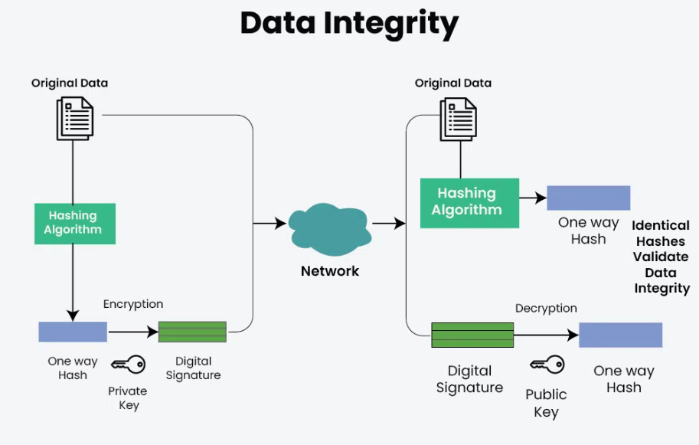

Slide 5
LITERATURE
Cryptographic hashing (MD5, SHA-1, SHA-256, SHA-512, SHA-3) is widely used to ensure file integrity by detecting even the smallest data changes (we use SHA-256).
Early research (Schneier et al., 1996) highlighted the importance of hashing for maintaining data authenticity and integrity.
Recent studies (Kim et al., 2020) show that combining hashing with real-time alert systems improves intrusion detection efficiency.
Advanced approaches include the use of AI/ML and blockchain to enhance security, reduce false positives, and create immutable records.
Challenges still exist such as hash storage security, computational overhead, and advanced cyberattacks, requiring continuous improvement.
This project takes inspiration from all of the above and builds a simpler, Python-based solution that is easy to use, flexible, and ready for real-world application.

Slide 6
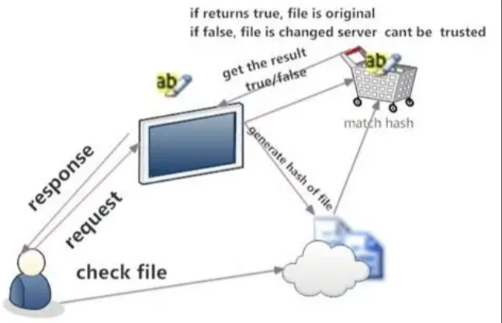
Flowchart of File Integrity Monitoring process

Slide 7
IMPLEMENTATION
Technology Used
Programming Language: Python
Library Used: hashlib
Core Functionality
Generates SHA-256 hash for each file
Reads file in chunks (efficient for large files)
Stores hash in hashes.txt
Compares current hash with stored hash

Slide 8
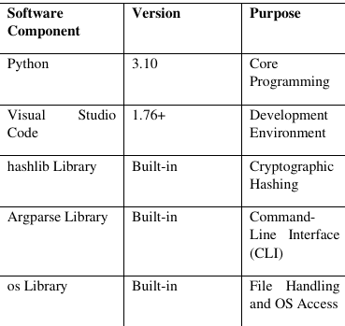

Slide 9
Code Snippet (Key Logic)
import hashlib def calculate_hash(file_path): sha256 = hashlib.sha256() with open(file_path, 'rb') as file: while chunk := file.read(1024): sha256.update(chunk) return sha256.hexdigest()

Slide 10
Working Logic
User inputs file path
System checks file existence
Generates new hash
Loads old hash from file
Compares both values
Displays result

Slide 11
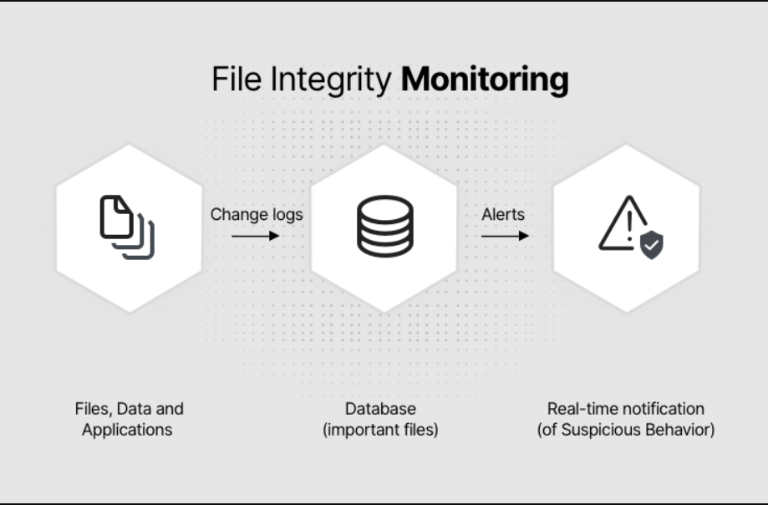
flowchart diagram for implementation
flowchart diagram for implementation

Slide 12
RESULTS
Test Results
No change in file → ✅ File is SAFE
After modification → ⚠️ WARNING: File MODIFIED
New file → Hash stored successfully
System Output
Successfully generated hash values for input files
Detected file status accurately (Safe / Modified)

Slide 13
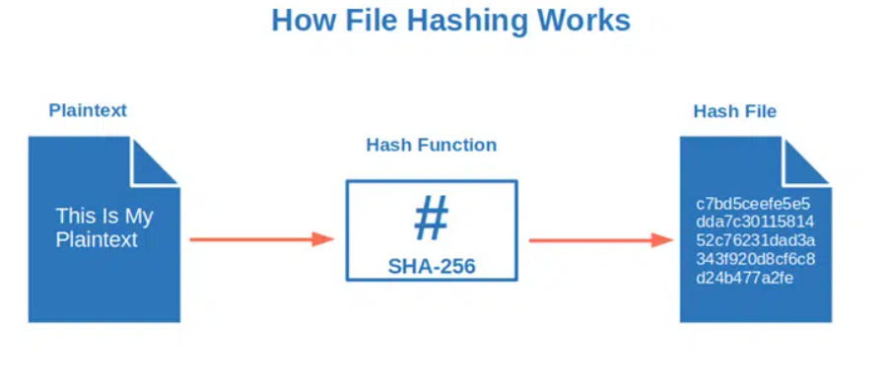

Slide 14
CONCLUSION
This project demonstrates that a simple File Integrity Monitoring System can effectively enhance data security.
It uses cryptographic hashing to accurately detect even minor unauthorized file changes.
The system successfully identifies file creation, modification, and deletion without generating false alerts.
It is lightweight, efficient, and easy to implement using Python.
However, it only detects changes after they occur and does not prevent them.
Despite this limitation, it is a valuable monitoring tool that improves security through timely alerts and response

Slide 15
RESEARCH PAPER
OVERVIEW
IMPLEMENTATION
🔹 Problem
Unauthorized file modification
Risk to data integrity & security
🔹 Proposed Solution
File Integrity Monitoring System (FIMS)
Uses cryptographic hashing
🔹 Method
Generate baseline hash
Compare with new hash
Detect changes & alert
🔹 Algorithms Used
SHA-256
🔹 Key Results
Accurate detection
Fast performance
Low resource usage
🔹 Conclusion
Reliable & secure system
Useful in real-world applications

Slide 16
REFERENCES
International Journal of Scientific Research and Engineering Development– Volume 8 Issue 2, Mar-Apr 2025.
Stallings, W. (2017). Cryptography and Network Security: Principles and Practice (7th ed.). Pearson.
PCI Security Standards Council. (2018). Payment Card Industry Data Security Standard (PCI-DSS) v3.2.1. Retrieved from www.pcisecuritystandards.org.
Patel, A., Mehta, R., & Singh, S. (2019). Hybrid Approaches for File Integrity Monitoring in Modern Security Systems. International Journal of Cyber Security, 12(4), 89-105.
im, J., Lee, H., & Park, S. (2020). Automated File Integrity Monitoring Systems for Cybersecurity.

Slide 17
Thank You

